Slide 1


MPC Lab – HMC Kick-Off Meeting
Eric Choi, Mark Pustilnik, Hansung Kim, and Francesco Borrelli
6/23/2025

Slide 2
Agenda
Project Overview
Review research goals & scope of work
Discussion
Future meeting times
Logistics

Slide 3
Project Overview

Slide 4


Project Overview
Title: Enhancing EV Energy Prediction Accuracy through Terrain-Aware Modeling
Duration: 7 months (June – December 2025)
Objective: Develop and validate a road grade-aware energy consumption estimation model for electric vehicles

Slide 5
Scope of Work
Data collection across flat, moderate, and steep road segments
Model development using physics-based or data-driven methods
System integration in a Python-based prototype tool
Performance evaluation via real-world testing
Research Goal:
Achieve ~10% improvement in energy prediction accuracy over baseline methods

Slide 6
Project Timeline
Progress Plan
Item | Details | Schedule (Month) |  |  |  |  |  |  | Remark
 |  | 1 | 2 | 3 | 4 | 5 | 6 | 7
Requirements and Data Acquisition | Define detailed requirements and success criteria and conduct a literature review on EV energy models
 | Plan Data Acquisition / Collect Data
Model & Algorithm Development | Develop the energy consumption estimation module
 | Integration and testing
Real-World Experiment | Deploy the system in the Hyundai IONIQ 5 for road testing
Evaluation and Improvement | Analyze the real-world test data, identify any gaps, refine the model, Fine-tune the algorithm
Final report | Wrap-up and submit a final report

Slide 7
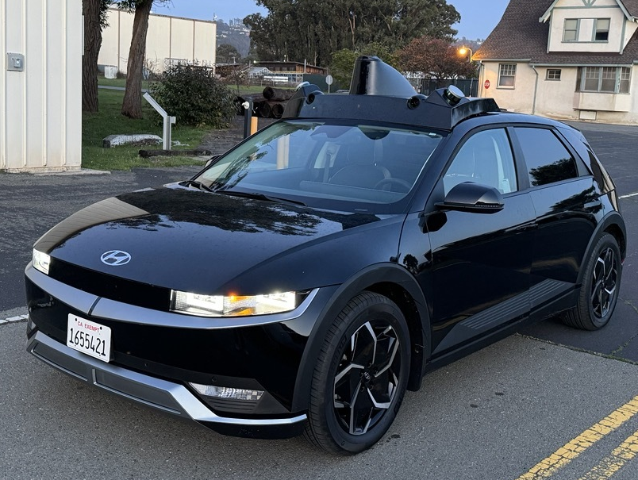
UCB Vehicle Platform
Model: 2023 Hyundai IONIQ 5
Signals:
Vehicle
Speed, wheel torque, etc.
Energy
High/Low voltage battery power, SOC, etc.
IMU
Accel., pitch angles, etc.
GPS
Latitude and Longitude
(optional) Altitude through Google or HERE API

Slide 8
Discussion

Slide 9
Tasks until the next meeting
Collect representative driving data across flat, moderate, and steep road segments to capture diverse road grade effects.
Analyze variations in energy consumption under different grade conditions.
List and evaluate energy estimation methods, including both model-based and data-driven approaches, with discussion on trade-offs, accuracy, and applicability.

Slide 10
Miscellaneous Discussion
Future meeting times
Files/code share environment

Slide 11
To do
Future meeting times: July 15 or July 16 KST
Files/code share environment
Through the email (only for small)
@Eric: try different file sharing methods, Box, dropbox, etc.
Visualize sample data sets, and get feedbacks (road grade)

